Slide 1
MAD about SMS
Mobile App Distribution using Twilio Rob Spectre, Dir. Devangelism
@dn0t – rspectre@twilio.com
Notes:
1

Slide 2
HOLY BISCUITS

Slide 3
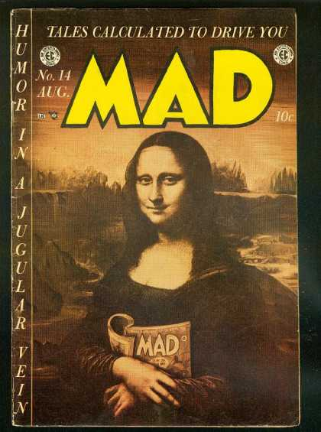
CALCULATED TALES

Slide 4
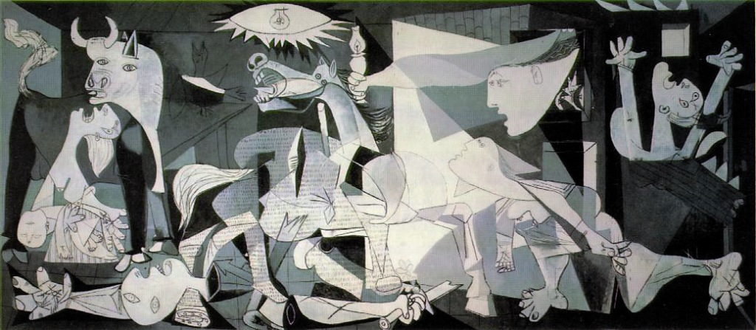
THE HORROR , THE HUMANITY

Slide 5
v4
Tweetcaster
small
normal
ICS
Gingerbread
320x480
Android
Sparrow
xlarge
iOS
Twitter
Default
Facebook
v5
Tweetbot
640x960
large
Gmail
Honeycomb
v6
Plume
CIRCLES, AW YEAH.

Slide 6
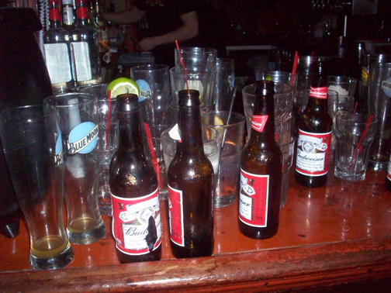
VENN WAS A DRINKER

Slide 7

WHAT, ME WORRY?

Slide 8
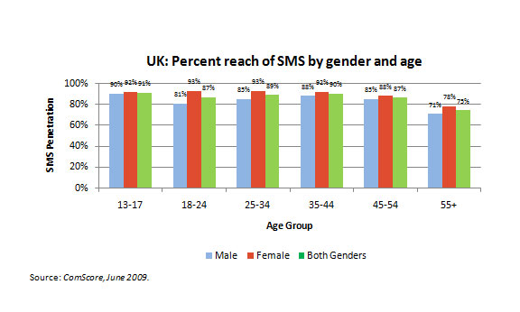
RESISTING ANOTHER BAR JOKE

Slide 9
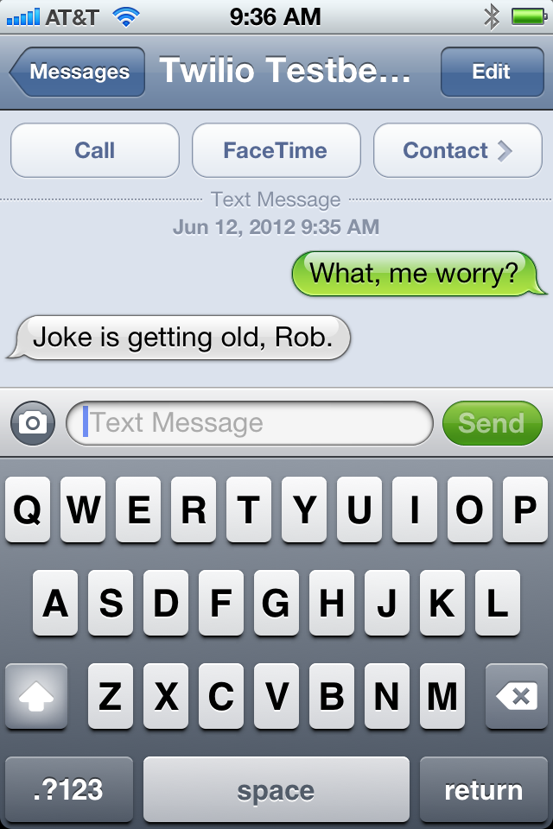
FLOGGING THAT HORSE

Slide 10
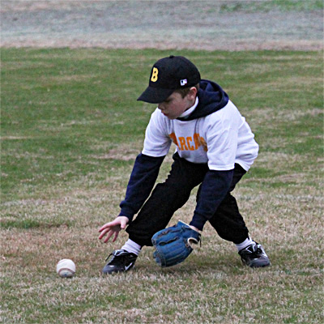
RED SOX NEED THE HELP

Slide 11
O HAI.

Slide 12

(AND WE MAKE YOUR PHONE RING TOO)

Slide 13
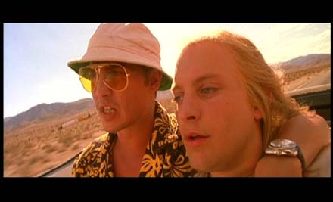
LET ME BRING YOU UP TO SPEED

Slide 14
HOW IT WORKS

Slide 15
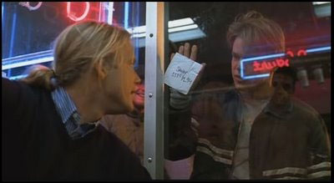
HOW DO YOU LIKE THEM APPLES?

Slide 16
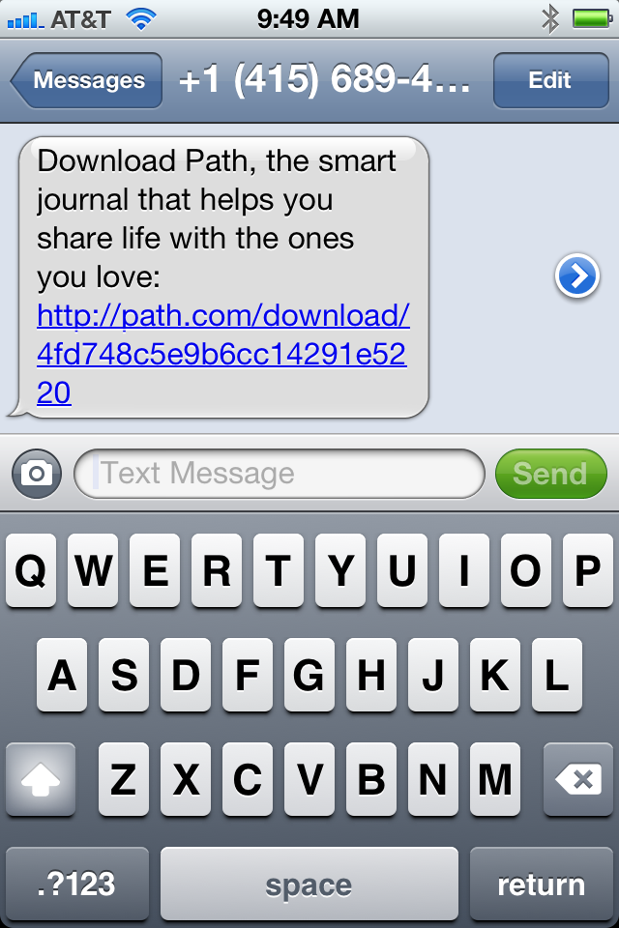
DOWNLOAD!

Slide 17
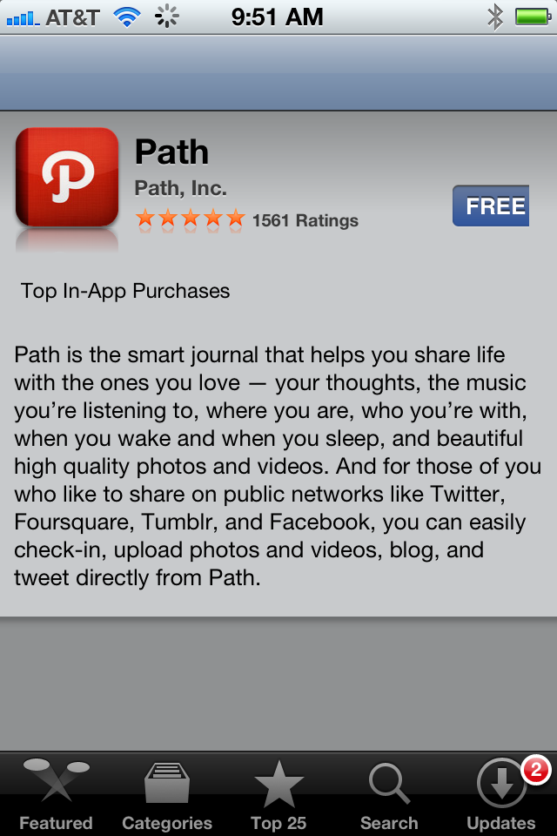
FIVE STAR EXPERIENCE

Slide 18
DO IT LIVE

Slide 19
KEY BENEFITS

Slide 20

DELIVERY IS CERTAIN

Slide 21

1 CENT. CHEAP!

Slide 22
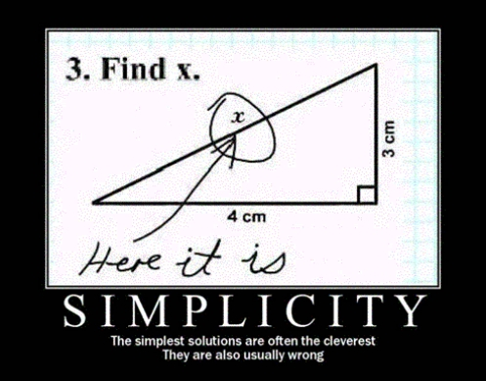
SIMPLE AS a2 + b2

Slide 23
PRO TIPS

Slide 24

MORE THAN JUST INVITATIONS

Slide 25
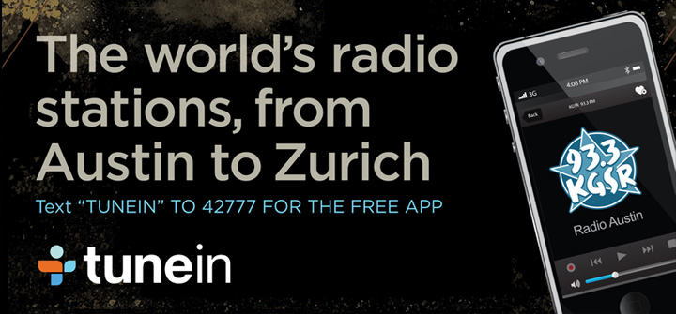
YOUR CREATIVES WANT SMS

Slide 26

REACH OUT AND TOUCH SOMEONE

Slide 27
CASE STUDIES

Slide 28
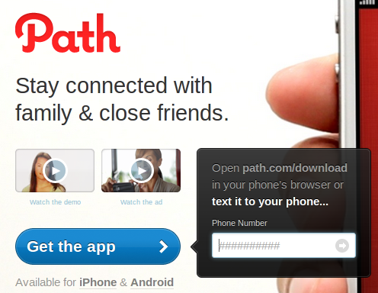
PATH

Slide 29
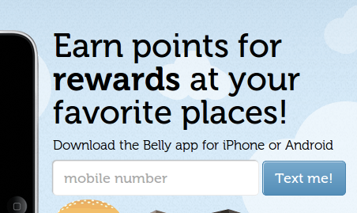
BELLY

Slide 30
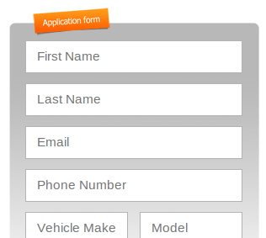
SIDECAR

Slide 31
THANK YOU
github.com/RobSpectre/Talks
@dn0t – rspectre@twilio.com
Notes:
31

